Slide 1

Leeds-Sharp
Machine Learning with ML.NET and Azure
25th October 2018

Slide 2
Who am I?
Andy Cross; andy@elastacloud.com; @andyelastacloud
Microsoft Regional Director
Azure MVP for 7 years
Co-Founder of Elastacloud, an international Microsoft Gold Partner specialising in data

Slide 3
What am I here to talk about?
Machine Learning
A new dotnet approach to data
ML.NET
Parquet.NET
Big Data in production
Relevant tools in Azure for data

Slide 4





.NET Core
3
2
.NET Core 3 expands supported workloads to include Windows Desktop, IoT & AI
.NET Core is perfectly suited for the requirements of cloud-native, cross-platform workloads
WEB
CLOUD
DESKTOP
IoT
AI
.NET CORE
.NET CORE 3
LIBRARIES
INFRASTRUCTURE
RUNTIME COMPONENTS
COMPILERS
LANGUAGES
Notes:
ANIMATED SLIDE – shows progression of entire .NET platform into .NET Core specific workloads.
Recap – assume no one knows anything about netcore
.NET Core is our cross-platform, open source implementation of .NET and is perfectly suited for requirements of cloud-native, cross-platform services. We’ve made significant investments in the core performance as well as the web stack so that you can easily take advantage of cloud patterns and scale.
.NET Core 3 will expand on the supported workloads to include IoT, AI and Windows Desktop.

Slide 5



Update .NET Framework Apps
Modernize Desktop Apps with .NET Core 3
Highly compatible updates
Install .NET Core updates per your
needs
Existing App
.NET Framework 4.8
.NET Core 3
Windows-only
Windows-only
Cross-platform
Highly-compatible, targeted improvements, like last few releases
UWP
WEB
DATA
AI/ML
WPF
ASP.NET Core
EF 6
EF Core
ML.NET
Windows Forms
.NET STANDARD
.NET Framework support unchanged (supported for life of Windows)
Side-by-side support
Self-contained EXEs
XAML Islands - WinForms & WPF apps can host UWP controls
Full access to Windows 10 APIs
FEATURES IN BOTH FXs
Notes:
.NET Framework will continue with highly-compatible targeted improvements like the last few releases and support will remain unchanged. You will be able to retarget existing apps to 4.8 and gain these improvements.
When you’re ready to move to .NET Core 3 (to take advantage of SxS install, interop between desktop app frameworks, and .NET Core performance) you can retarget and rebuild your apps to .NET Core.

Slide 6
What is machine learning?
And what does it mean to say “Artificial Intelligence”

Slide 7
Machine learning for prediction talk quality
Formal definition: -
"A computer program is said to learn from experience E with respect to some class of tasks T and performance measure P if its performance at tasks in T, as measured by P, improves with experience E.“
E = historical quantities of beer consumed and corresponding audience ratings
T = predicting talk quality
P = accuracy of the talk quality prediction

Slide 8
Types of machine learning
Two most commonly used machine learning methods: -
Supervised
the computer is presented with example inputs and their desired outputs, given by a "teacher“
goal is to learn a general rule that maps inputs to outputs
Unsupervised
no desired outputs (“labels”) are given to the computer, leaving it on its own to find structure in the input
the goal may be to discover hidden patterns or groups in the data

Slide 9
Examples tonight
Sentiment analysis of website comments
Finding mappings of historic taxi fares
Predicting the most likely group of flowers a certain flower belongs to
Time Series
Image Recognition
NOTE: We reuse algorithms; to do so in most cases is akin to writing a new database to write a website – a vast overreach of engineering

Slide 10
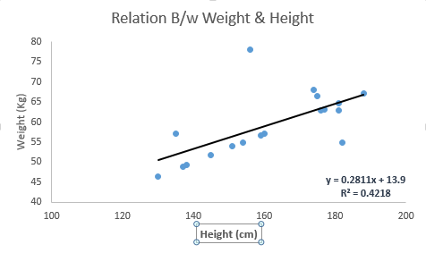
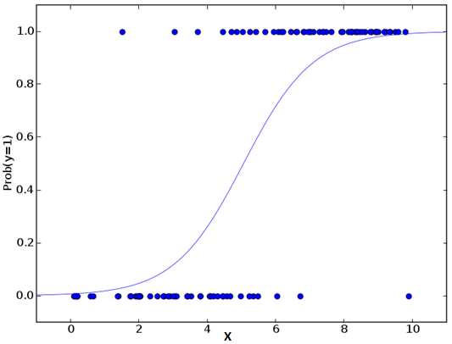
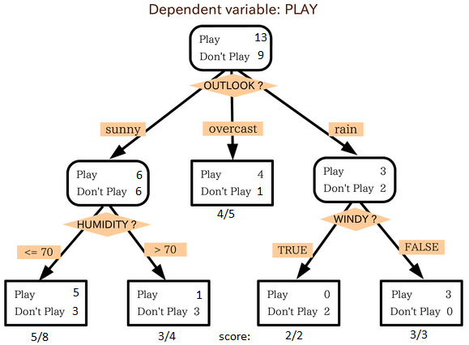
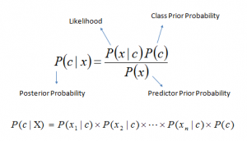
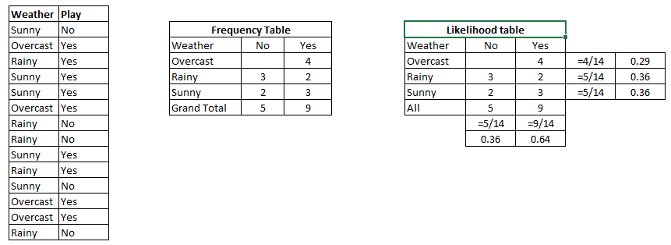
Machine Learning
Algorithms
Linear Regression
Logistic Regression
Decision Tree
Naive Bayes
kNN
K-Means
Dimensionality Reduction Algorithms
Gradient Boosting algorithms
GBM
XGBoost

Slide 11
Machine learning best practice
Machine learning should be approached in a methodical manner, in this way we are more likely to achieve accurate, reliable and generalisable models
This is achieved by following best practice for machine learning
Best practice mostly revolves around how the data is used

Slide 12
Machine learning best practice
Data preparation
Ensure that the feature do not contain future data (aka time-travelling)
Training, validation and testing data sets
Cross validation
Think of this as using mini training and testing data sets to find a model that generalises to the problem
Validation and testing data sets
Data that the model has never seen before – simulate the future
Gives a final ‘sanity’ check of our model’s performance

Slide 13
Model training
Provide an algorithm with the training data set
The algorithm is ‘tuned’ to find the best parameters that minimise some measure of error

Slide 14
Model testing
To ensure that our model has not overfit to the training data it is imperative that we use it to predict values from unseen data
This is how we ensure that our model is generalisable and will provide reliable predictions on future data
Use a validation set and test sets

Slide 15
Validation set
The validation set is randomly chosen data from the same data that the model is trained with – but not used for training
Used to check that the trained model gives predictions that are representative of all data
Used to prevent overfitting
Gives a ‘best’ accuracy

Slide 16
Test set
The test set data should be ‘future’ data
We simulate this by selecting data from the end of the available time-frame with a gap
Use the trained model to predict for this
More realistic of the model in production
Gives a conservative estimate of the accuracy

Slide 17
Validation and test sets
Test 1
Test 2
01/01/15
04/02/17
09/06/17
21/06/17
01/11/17
13/11/17
= Training data
= Validation data
= Testing data
= Ignored data

Slide 18
Model training, validation and testing
Train with cross validation to find best parameters
Assess overfitting on validation set
Retrain with best parameters on training data set
Evaluate performance on test data sets

Slide 19
How does this relate to Big Data?

Slide 20
Distributed Computing
Break a larger problem into smaller tasks
Distribute tasks around multiple computation hosts
Aggregate results into an overall result
Types of Distributed Compute
HPC – Compute Bound
Big Data – IO Bound
Big Data – Database free at scale IO over flat files

Slide 21
Freed of historic constraints
Algorithms such as we’ll see tonight are not new
From the 1960s many
The difference is the ability to show the algorithm more examples
Removing IO bounds gives us access to more data
Removing CPU bounds allows us to compute over larger domains

Slide 22
Azure Services for Distributed Compute
Azure Batch
Azure HDInsight
Azure Databricks
Bring your own partitioner
Azure Functions
Azure Service Fabric (Mesh)
Virtual Machines
ACS/AKS

Slide 23
Azure Services for ML

Slide 24
Various places for ML
Azure Databricks
Azure HDInsight
Azure Data Lake Analytics
Azure ML
V1
V2 with Workbench
V2 RC no Workbench
R/Python in many hosts
Functions
Batch
SQL Database
C# and dotnet hosted in many places
Typical Azure DevOps pipelines more mature for .NET

Slide 25
Azure Databricks
Databricks Spark hosted as SaaS on Azure
Focussed on collaboration between data scientists and data engineers
Powered by Apache Spark
Dev in:
Scala
Python
Spark-SQL
More?

Slide 26
Collaboration in Databricks
Collaborative Editing
Switch between Scala, Python, R & SQL
On notebook comments
Link notebooks with GitHub
Notes:
Notebooks have a primary language R, Python & Scala
Use magic to change language
Supports SQL, R, Python & Scala
Create table from dataframe in any language to share between spark contexts
Easy to pair to translate

Slide 27
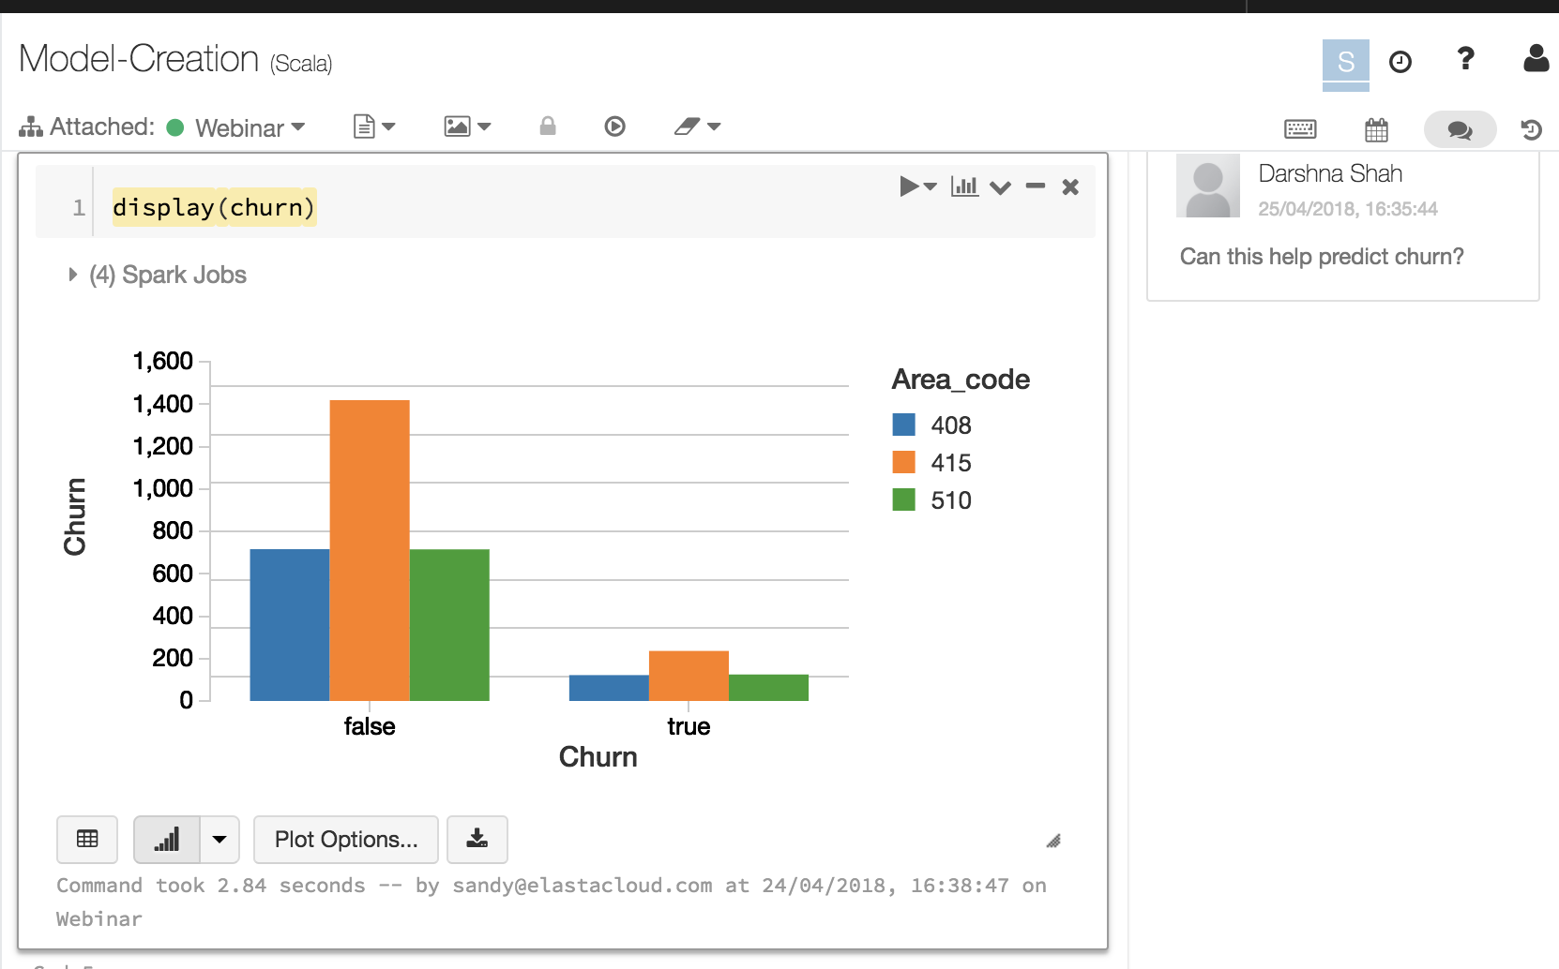
Databricks Notebooks Visuals
Visualisations made easy
Use popular libraries – ggplot, matplotlib
Create a dashboard of pinned visuals
Use Pip, CRAN & JAR packages to add additional visual tools
Notes:
Treat Notebooks as pseudo-OO call out to function or values in other notebooks, can be combined with if / switch logic etc
Chain notebooks passing data frames and resources from one to another
Schedule notebooks
Plots make easy one line display(dataframe)
GUI driven experience between plots with drag and drop
Use SQL, R, Python & Scala as primary language
Support for popular visual libraries including GGPlot & Matplotlib
Pip, R & JAR packages to add additional visuals
Interactive Visuals i.e. Plotly
Create a Dashboard of pinned visuals

Slide 28

Azure HDInsight
Multipurpose Big Data platform
Operates as a host and configurator for various tools
Hadoop
Hive
Hbase
Kafka
Spark
Storm

Slide 29
Revolutionising data for dotnet

Slide 30






Data Landscape
.NET
Operationalisation mandates database rectangularisation to take advantage of ADO.NET
Utilising System.IO is unstructured, our evidence is that most users handroll some form of CSV/TSV or use JSON encoding as it is a safe space.
Parquet
.NET
First stage transcoding from “something .NET can write to”
All subsequent data inspection and manipulation outside of .NET

Slide 31

Data Landscape
.NET can read operational output from ML and Big Data natively using Parquet.net
.NET
Machine Learning for .NET
Utilising System.IO is unstructured, our evidence is that most users handroll some form of CSV/TSV or use JSON encoding as it is a safe space.
Parquet
Parquet.NET
.NET
Immediately serialize .NET POCOs to Parquet
Parquet specific optimisation and inspection tools in .net

Slide 32
Introduction to ML.NET
With Example in Sentiment Analysis with Binary Classifier

Slide 33
0.6.0 Goodbye: ML.NET Pipelines
Library evolving quickly
Towards common approach in Spark/SciKit-Learn
LearningPipeline weaknesses:
Enumerable of actions not common elsewhere
Logging and State not handled
Bring in Context, Environment and lower level data tools IDataView
Not all <0.6.0 features available, so later demos are “Legacy”

Slide 34
Sentiment Analysis
By showing examples of content and a Toxic bit flag, learn that makes things Toxic
The quality of the model reflects the quality of the data
Representation
Variety
Breadth

Slide 35
Testing and Training Data
Tab Separated, two columned data set with headers.
Sentiment | SentimentText
1 | ==You're cool== You seem like a really cool guy... *bursts out laughing at sarcasm*.
0 | I just want to point something out (and I'm in no way a supporter of the strange old git), but he is referred to as Dear Leader, and his father was referred to as Great Leader.
1 | ==RUDE== Dude, you are rude upload that carl picture back, or else.
0 | " : I know you listed your English as on the ""level 2"", but don't worry, you seem to be doing nicely otherwise, judging by the same page - so don't be taken aback. I just wanted to know if you were aware of what you wrote, and think it's an interesting case. : I would write that sentence simply as ""Theoretically I am an altruist, but only by word, not by my actions."". : PS. You can reply to me on this same page, as I have it on my watchlist. "

Slide 36
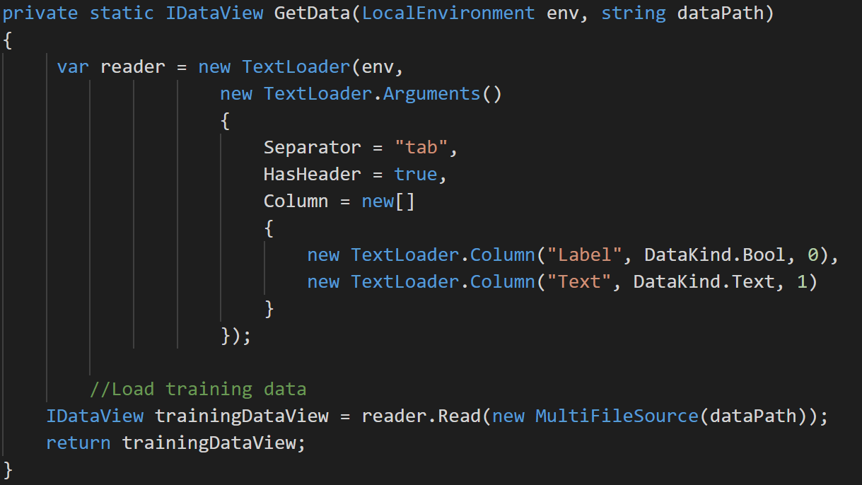

Slide 37
Simple to build classifier
var pipeline = new TextTransform(env, "Text", "Features") .Append(new LinearClassificationTrainer(env, new LinearClassificationTrainer.Arguments(),
"Features",
"Label"));
var model = pipeline.Fit(trainingData);

Slide 38
Evaluation of Models
PredictionModel quality metrics evaluation
------------------------------------------
Accuracy: 94.44%
Auc: 98.77%
F1Score: 94.74%
IDataView testData = GetData(env, _testDataPath);
var predictions = model.Transform(testData);
var binClassificationCtx = new BinaryClassificationContext(env);
var metrics = binClassificationCtx.Evaluate(predictions, "Label");

Slide 39
Demo

Slide 40
Data
Loading and Transforming data in a pipeline

Slide 41
Supported Types
Text (CSV/TSV)
Parquet
Binary
IEnumerable<Τ>
File sets

Slide 42
The problem with flat files
With no database or storage engine Data is written arbitrarily to disc
Format errors
Caused by bug
Caused by error
Inefficiencies
Compression an afterthought
GZIP splittable problem

Slide 43
More problems with flat files
Access errors
Mutability
Variability between files in a fileset
Naivety
Just because brute force scanning is possible doesn’t mean it’s optimal
Predicate Push-Down
Partitioning

Slide 44
Parquet
Apache Parque is a file format, primarily driven from Hadoop Ecosystem, particularly loved by Spark
Columnar format
Block
File
Row Group
Column Chunk
Page

Slide 45
Designed for Data(!)
Schemas consistent through file
Held at the end so can be quickly seeked
By Convention: WRITE ONCE
Parallelism:
Partition workload by File or Row Group
Read data by column chunk
Compress per Page

Slide 46
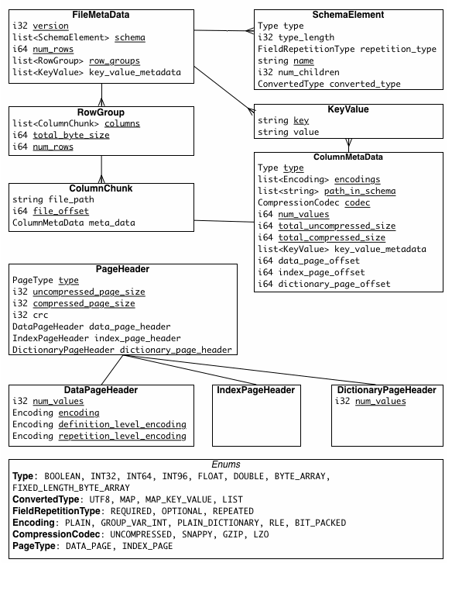

Slide 47
Parquet.NET
Until recently no approach available to .NET
Leading to System.IO to write arbitrary data and then requiring data engineering to sort the data out
Libraries for cpp can be used
Implementation by G-Research called ParquetSharp uses Pinvoke
A full .NET Core implementation is Parquet.NET
https://github.com/elastacloud/parquet-dotnet

Slide 48
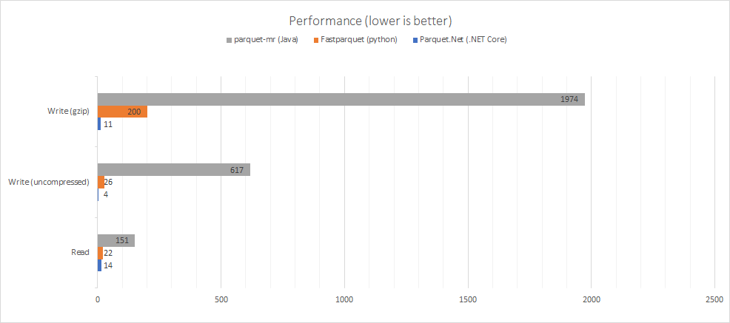

Slide 49
Parq!
End to end tooling for .NET devs on a platform they’re familiar with.
Uses dotnet global tooling

Slide 50
Futures
Arrow.NET

Slide 51
Demo of Parquet.NET

Slide 52
Regression analysis

Slide 53
What is regression?
Supervised Machine Learning
Features go to a Label
Label is a “real value” not a categorical like in classification
Regression algorithms generate weights for features

Slide 54
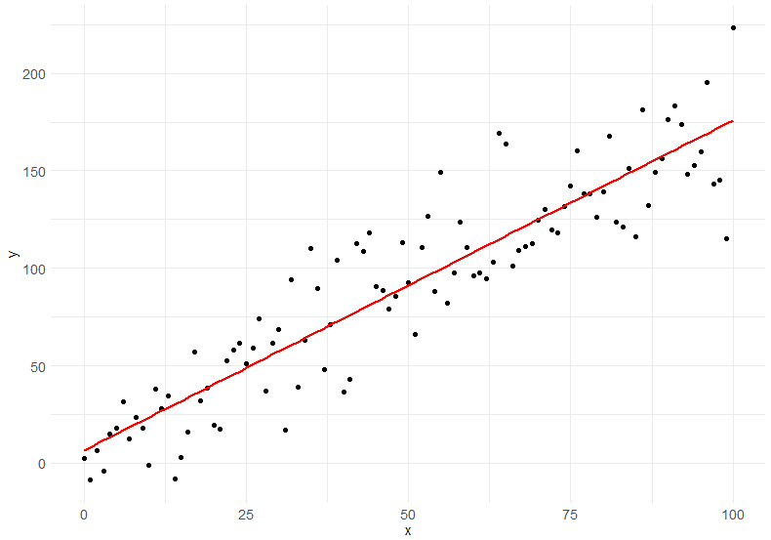

Slide 55
Taxi Fare Data
NYC data
Taxi Fares, Time, Distance, Payment Method etc
Use these as features and predict the most likely Fare ahead of time.

Slide 56
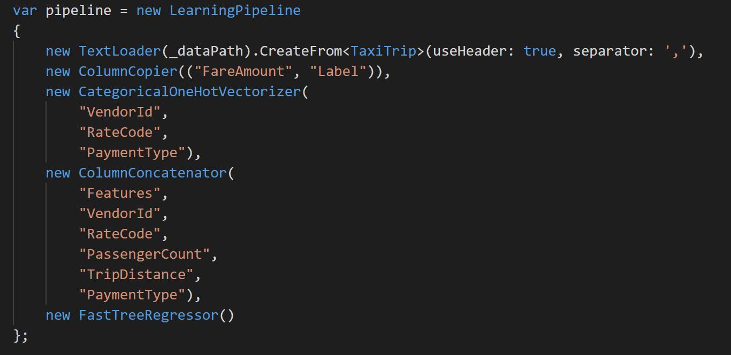

Slide 57
Demo

Slide 58
Evaluation with RMS and r²
Rms = 3.30299146626885
RSquared = 0.885729301000846
Predicted fare: 31.14972, actual fare: 29.5

Slide 59
Coefficient of Determination
r² is the proportion of the variance in the dependent variable that is predictable from the independent variables

Slide 60
How good a fit is my line?

Slide 61
Compared to….

Slide 62
Compared to….

Slide 63
Compared to….

Slide 64
What does it tell us?
In a multiple-regression model to determine solar energy production:
The energy production is the dependent variable (Y)
The cloud cover level is an independent variable (X1)
The season of year is an independent variable (X2)
Y = X1*weightX1 + X2*weightX2
It’s a coefficient (ratio) of how good my predictions are versus the amount of variability in my dependent variable.

Slide 65
How does it do that?
It measures the relationship between two variables:
Y-hat : ŷ
The estimator is based on regression variables, Intercept, X Variable 1 to X Variable n
The distance from this estimator (prediction) and the real y value (y- ŷ)
Squared
Y-bar : ȳ
The average value of all Ys
The distance of the real y value from the mean of all y values (y-ȳ), which is how much the data varies from average
Squared
These two squares are summed, and calculated:
1-(((y-ŷ)^2)/((y-ȳ)^2))
1-(estimation error/actual distance from average)

Slide 66
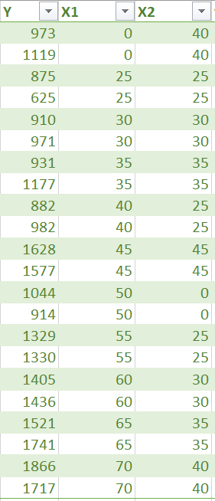
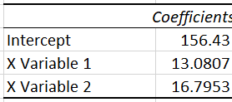
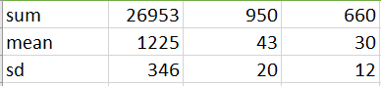
Y is our actual value: Energy generation
X1 is our first input value we want to predict from, X2 our second: Irradiance Percentage and Days left until service
The data science team works hard to understand the data and model it, which means produce weights for how much each input variable affects the actual value
If you were to plot out these values Intercept + X1 * X Variable 1 + X2 * X Variable 2
You would get a straight line like the red one above
(weightX1)
(weightX2)

Slide 67
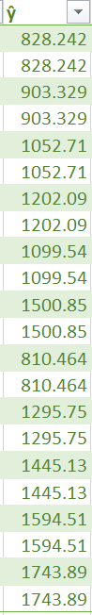
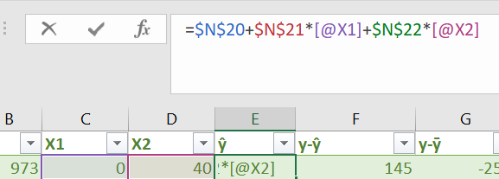
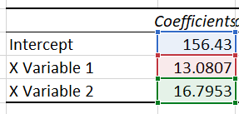
To calculate a prediction (called y-hat) we add the intercept to the variable values multiplied by their modifiers (coefficient)

Slide 68
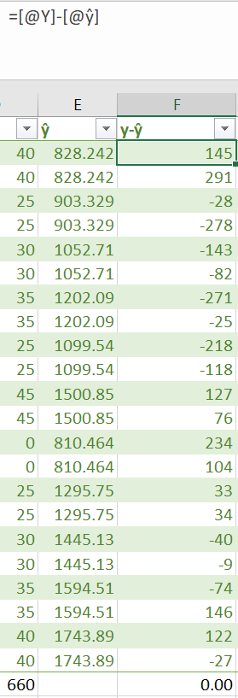
IF we take away the prediction (estimator) from the actual value we have the residual, or the size of the error. If this is too high, the error is positive, if the number is too low, the error is negative.
You might sometimes hear data scientists talking about residuals; these are the residuals.
It is simply the actual value minus the prediction.

Slide 69
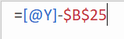
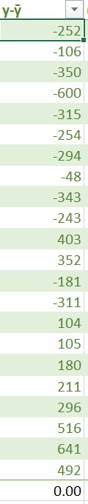
We can also measure the difference between the observed actual value and the average (mean) of the whole set of actuals.
This gives us a distance measure of variance, how far the actual varies from the average value of the actuals. This is a measure of the variance of the data.
If the number is bigger than average, the number is positive, if it is smaller than average, the number is negative.

Slide 70
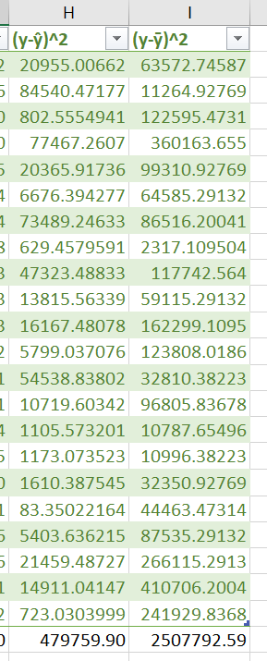
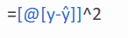
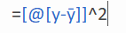
Both the size of the measures we just created have a sum of 0, because some values are bigger and some smaller than the actuals. This means when they get added up they cancel out to 0.
This is correct, but we are trying to compare the sizes of the errors, not whether they are above or below actual, so we need to lose the sign and make everything positive.
The way we’ll do that is by times-ing the number by itself (squaring the number), as -1*-1 = 1, -2 * -2 = 4 etc
Adding all these up across the set gives us the sums of squares

Slide 71
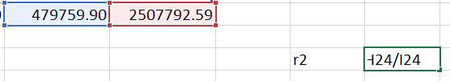
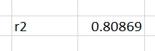
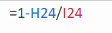
We then divide the sum of squares of our estimator error by the sum of squares of our distance from average. The estimator errors are always lower than the variance of the data, and we take the result from 1, to give us a value like 0.80, which we shouldn’t describe as 80% accurate, but you can think of it along these lines; 80% of variance is explained by the model.

Slide 72
Root Mean Squared Error
RMSE is the average of how far out we are on an estimation by estimation basis

Slide 73
How close to my line are my points on average?

Slide 74
How close to my line are my points on average?

Slide 75
A measure of the average broadness of the line

Slide 76
What does it tell us?
By comparing the average distance between the estimator ŷ and the observed actual, we can get a measure of how close in real world terms we are on average to the actual.
Unlike r² which gives an abstract view on variance, RMSE gives the bounds to the accuracy of our prediction.
On average, the real value is +/- RMSE from the estimator.

Slide 77
How do we calculate it?
It’s very easy and we’ve already done the hard work.
The MSE part means average of the squared distance of the estimator from the actual
=AVERAGE(data[(y-ŷ)^2])
Since the values were squared, this number is still big; square rooting this gives us a real world value.
=SQRT(AVERAGE(data[(y-ŷ)^2]))

Slide 78
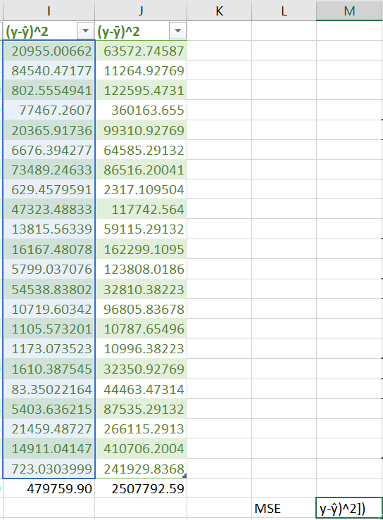
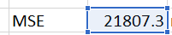
Take the average of the squared estimator distance from actual.
Squaring it earlier was useful, as the non-squared value averages out to zero!

Slide 79
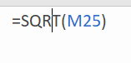
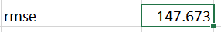
Since the MSE is still in the order of magnitude of the Squares, square root it to give us a real world value and this is Root Mean Square Error (RMSE).
In this example, the estimate is on average 147.673 away from the actual value.

Slide 80
This model can therefore be described as: being able to describe 80% of variance being on average 147.6 away from the actual

Slide 81
Clustering
Example of the Iris petal detector

Slide 82
What is Clustering
Used to generate groups or clusters of similarities
Identify relationships that are not evident to humans
Examples may be:
Who is a VIP customer?
Who is cheating in a game?
How many people are likely to drop out of class?
Which components in manufacturing are likely to fail?

Slide 83
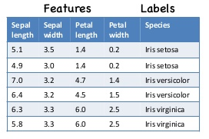
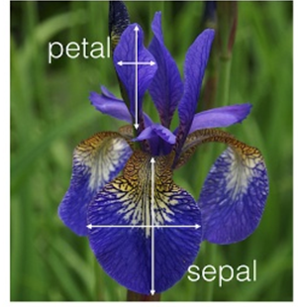
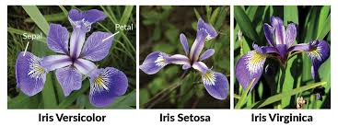
Example: Iris flower

Slide 84
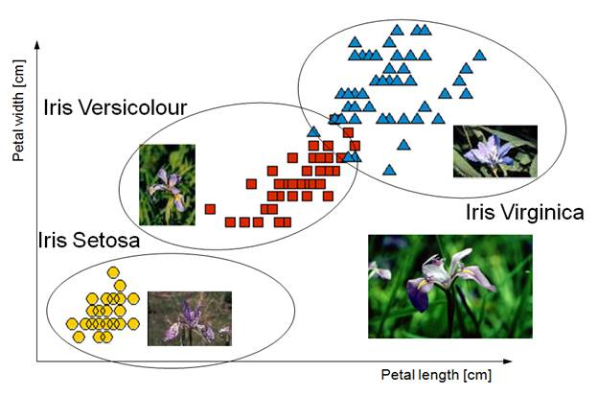
Supervised Learning
Definition
You give the input data (X) and an output variable (Y) (labels), and you use an algorithm to learn the mapping function from the input to the output. Y = f(X)
Techniques
Classification: you want to classify a new input value. Regression

Slide 85
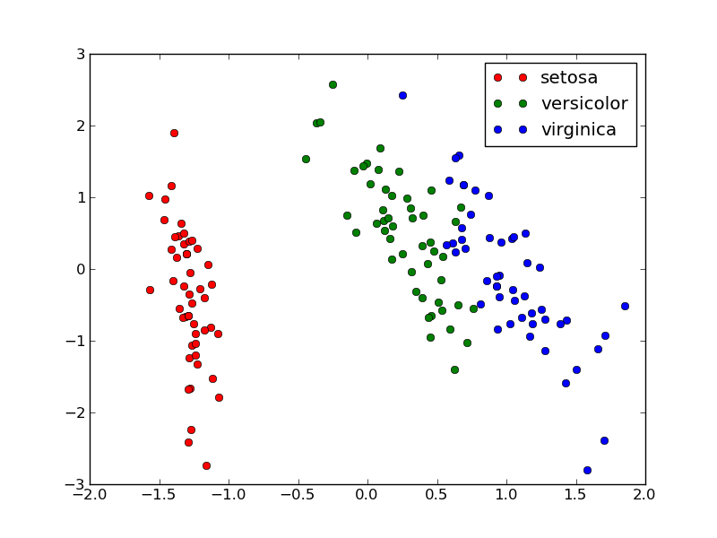
Unsupervised Learning
Definition
You give the input data (X) and no corresponding output variables (labels).
Techniques
Clustering: you want to discover the inherent groupings in the data. Association: you want to discover rules that describe large portions of your data.

Slide 86
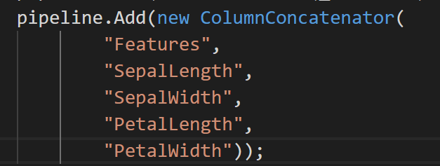
As easy as omitting the input label

Slide 87
Choose a clusterer
Hyperparameters

Slide 88
Demo

Slide 89
Operationalization
Loading and not Training

Slide 90
Time Series

Slide 91
Interoperability
Loading trained models from other frameworks

Slide 92
TensorFlow since 0.5.0
Additional work for:
CNTK
Torch
This means ML.NET can be the OSS, XPLAT host for many data science frameworks, anywhere that NETCORE runs.
On devices with Xamarin, on edge devices, on web servers.

Slide 93
Demo

Slide 94
Summary

Slide 95





Unified Cloud Data Environment
Suppliers
Excel
Landing
Staging
Enriched
Input Files
XML
Excel
Parquet
Parquet
Other
XML
Validated once and for all, optimised for processing
Results of machine learning experiments
Ecosystem Participants
Parquet.NET
ML.NET
Other
A true copy of the input data, used to trace linage and rebuild data
Operationalised
Any combination of modern data platform to support visualisations and operational systems
Stream

Slide 96
Epilogue: The business of ML

Slide 97
The questions to answer
Opportunity discovery
What can we do?
Adoption
How do I get my company to use this?
Sustainability
How do we control costs and/or build a viable price point?
Measurement
How do we know it’s generating value?
Build
Use
Profit

Slide 98
The end goals
Providing better customer service and experience
Better products
Self-healing and self-improving
Improving operational processes and resource consumption
Faster Time to Market
Lighter Bill of Materials
Stronger Supply Chain
New business models
Insights from data
Different pricing models

Slide 99
Mental Models
Dive deeper into strategic modelling with these mental models

Slide 100
Mental Models
In order to envision the transformation possibilities, adopt the following mental models.
AI is an extremely focussed entry level clerical assistant
AI is exceptionally reactive
AI is auditable, repeatable, improvable
AI is resistant of external bias

Slide 101
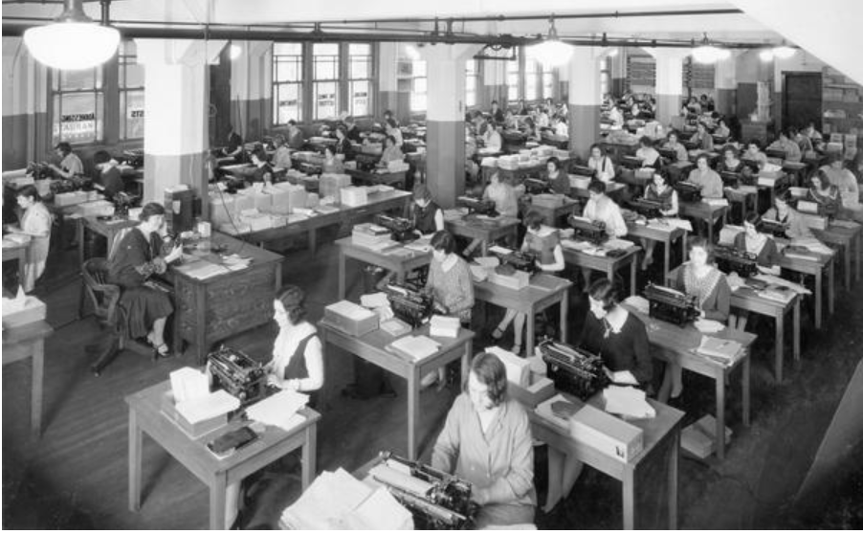
One Million Clerical Workers What is achievable with a million trained office workers?

Slide 102
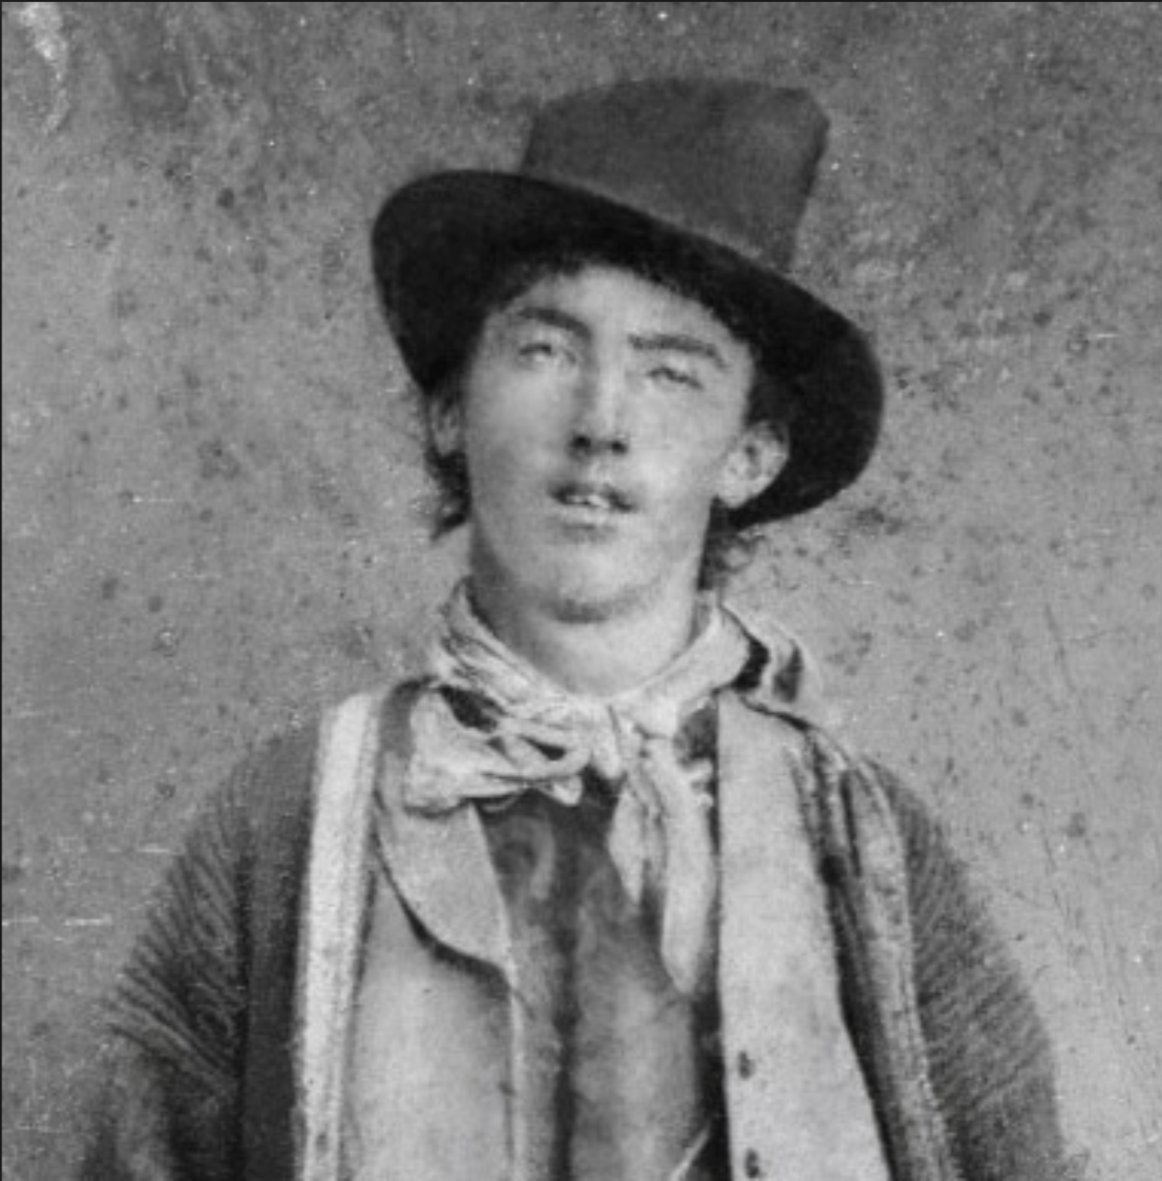
Billy the Kid Reaction Times What if all workers can react and form a course of action in 1 millisecond?

Slide 103
Auditable Actions What if all actions and their impact were measurable and qualified?
Great companies have high cultures of accountability, it comes with this culture of criticism […], and I think our culture is strong on that.
Steve Ballmer

Slide 104
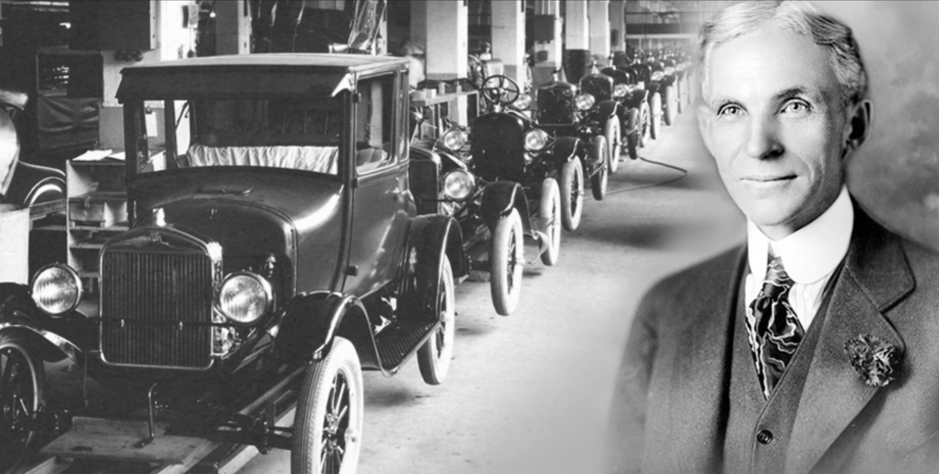
Cement the views of the Founders What if the decision making process of the hyper-successful founders was cemented and eternally referenceable? Resistant to the distractions of hype and false promises.

Slide 105
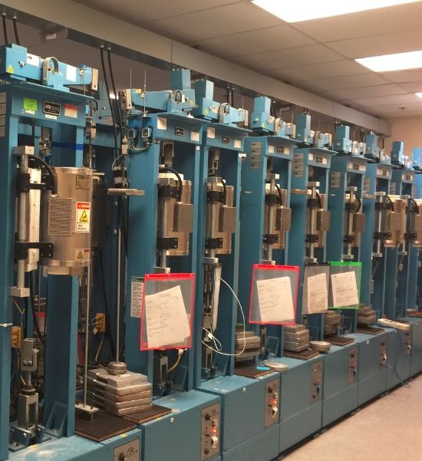
All tools are Smart Tools What if every tool used by a business was as smart as a person. A forklift could tell you the context of a crate was the wrong weight. A machine could tell you it was feeling unwell. A room could tell you someone had left a dangerous tool in an unsafe state.

Slide 106
Regarding Maintenance Contracts

Slide 107
JIT Service Regimes
Migrate from manufacturer led maintenance cycles to just-in-time
Use data to establish mean time to failure
Conditional maintenance

Slide 108

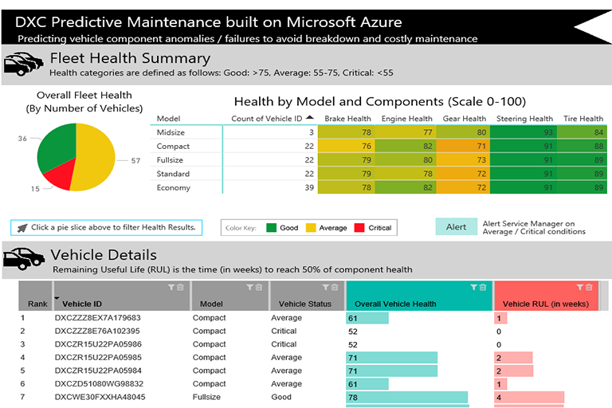
Alarm
- Predictions through AI become an integral part of business reporting
~ 1 minute telemetry
AzureML
through dedicated cloud gateway
- Machine Learning used in real-time with “Anomaly Detection” which enables history to be assessed and false positive spikes in behaviour to be discarded
- Model retraining can occur to help understand acceptable lowering of efficiency as equipment degrades over time within acceptable parameters
Reporting

Slide 109
Supplier efficiency
Use data to judge the reliability of assets
Track fault recurrence and resolution speeds
Contract with SLAs around reducing outages

Slide 110
Warehouse and Inventory Management

Slide 111
JIT Warehousing
Regarding Parts
JIT Maintenance leads to JIT Warehousing
Regarding Fuel
Integrated Data streams including ERP and CRM
Manage the supply chain and keep the right stock level

Slide 112

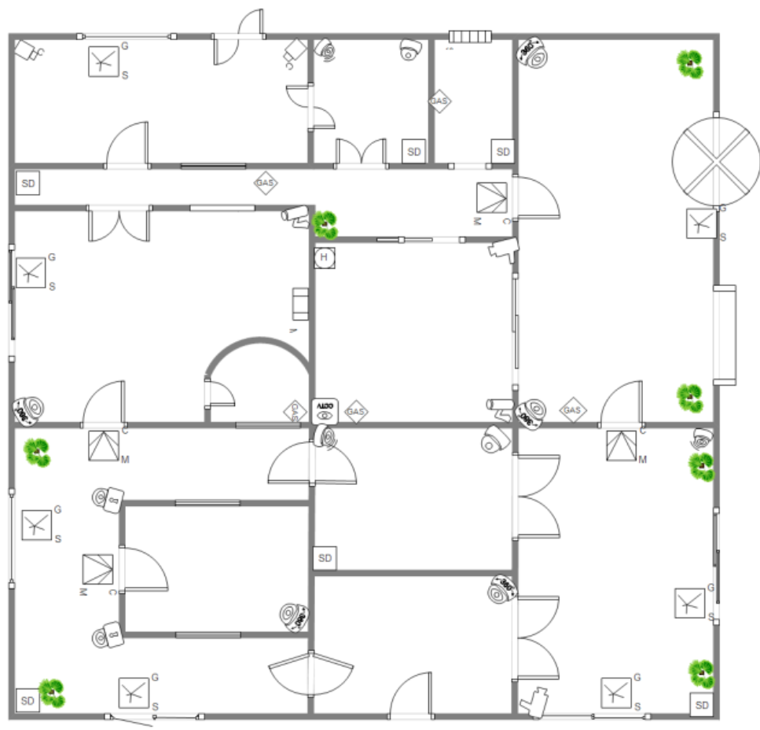

G4S Data Science Programme
G4S plc is a British multinational security services company and operates an integrated security business in more than 90 countries across the globe.
They aim to differentiate G4S by providing industry leading security solutions that are innovative, reliable and efficient.
Aim: Predict anomalous card activity in monitored buildings

Slide 113
Epilogue II: Running a DSci team

Slide 114


Data Science Conceptual Model – Crisp DM outline Methodology
Business Understanding
IDENTIFYING YOUR BUSINESS GOALS
A problem that your management wants to address
The business goals
Constraints (limitations on what you may do, the kinds of solutions that can be used, when the work must be completed, and so on)
Impact (how the problem and possible solutions fit in with the business)
ASSESSING YOUR SITUATION
Inventory of resources: A list of all resources available for the project.
Requirements, assumptions, and constraints:
Risks and contingencies:
Terminology
Costs and benefits:
DEFINING YOUR DATA-MINING GOALS
Data-mining goals: Define data-mining deliverables, such as models, reports, presentations, and processed datasets.
Data-mining success criteria: Define the data-mining technical criteria necessary to support the business success criteria. Try to define these in quantitative terms (such as model accuracy or predictive improvement compared to an existing method).
PRODUCING YOUR PROJECT PLAN
Project plan: Outline your step-by-step action plan for the project. (for example, modelling and evaluation usually call for several back-and-forth repetitions).
Initial assessment of tools and techniques
Business
Objective
Business Understanding
Data Understanding
Deployment
Data Science Team
Data Preparation
Modelling and Evaluation

Slide 115
Data Science Conceptual Model – Crisp DM outline Methodology
Data Understanding
GATHERING DATA
Outline data requirements: Create a list of the types of data necessary to address the data mining goals. Expand the list with details such as the required time range and data formats.
Verify data availability: Confirm that the required data exists, and that you can use it.
Define selection criteria: Identify the specific data sources (databases, files, documents, and so on.)
DESCRIBING DATA
Now that you have data, prepare a general description of what you have.
EXPLORING DATA
Get familiar with the data.
Spot signs of data quality problems.
Set the stage for data preparation steps.
VERIFYING DATA QUALITY
The data you need doesn’t exist. (Did it never exist, or was it discarded? Can this data be collected and saved for future use?)
It exists, but you can’t have it. (Can this restriction be overcome?)
You find severe data quality issues (lots of missing or incorrect values that can’t be corrected).
Business
Objective
Business Understanding
Data Understanding
Deployment
Data Science Team
Data Preparation
Modelling and Evaluation

Slide 116
Data Science Conceptual Model – Crisp DM outline Methodology
Data Preparation
SELECTING DATA
Now you will decide which portion of the data that you have is actually going to be used for data mining.
The deliverable for this task is the rationale for inclusion and exclusion. In it, you’ll explain what data will, and will not, be used for further data-mining work.
You’ll explain the reasons for including or excluding each part of the data that you have, based on relevance to your goals, data quality, and technical issues
CLEANING DATA
The data that you’ve chosen to use is unlikely to be perfectly clean (error-free).
You’ll make changes, perhaps tracking down sources to make specific data corrections, excluding some cases or individual cells (items of data), or replacing some items of data with default values or replacements selected by a more sophisticated modelling technique.
CONSTRUCTING DATA
You may need to derive some new fields (for example, use the delivery date and the date when a customer placed an order to calculate how long the customer waited to receive an order), aggregate data, or otherwise create a new form of data.
INTEGRATING DATA
Your data may now be in several disparate datasets. You’ll need to merge some or all of those disparate datasets together to get ready for the modelling phase.
FORMATTING DATA
Data often comes to you in formats other than the ones that are most convenient for modelling. (Format changes are usually driven by the design of your tools.) So convert those formats now.
Business
Objective
Business Understanding
Data Understanding
Deployment
Data Science Team
Data Preparation
Modelling and Evaluation

Slide 117
Data Science Conceptual Model – Crisp DM outline Methodology
Modelling and Evaluation (Modelling)
SELECTING MODELING TECHNIQUES
Modelling technique: Specify the technique(s) that you will use.
Modelling assumptions: Many modelling techniques are based on certain assumptions.
DESIGNING TESTS
The test in this task is the test that you’ll use to determine how well your model works. It may be as simple as splitting your data into a group of cases for model training and another group for model testing.
Training data is used to fit mathematical forms to the data model, and test data is used during the model-training process to avoid overfitting
BUILDING MODEL(S)
Parameter settings: When building models, most tools give you the option of adjusting a variety of settings, and these settings have an impact on the structure of the final model. Document these settings in a report.
Model descriptions: Describe your models. State the type of model (such as linear regression or neural network) and the variables used.
Models: This deliverable is the models themselves. Some model types can be easily defined with a simple equation; others are far too complex and must be transmitted in a more sophisticated format.
ASSESSING MODEL(S)
Model assessment: Summarizes the information developed in your model review. If you have created several models, you may rank them based on your assessment of their value for a specific application.
Revised parameter settings: You may choose to fine-tune settings that were used to build the model and conduct another round of modelling and try to improve your results.
Business
Objective
Business Understanding
Data Understanding
Deployment
Data Science Team
Data Preparation
Modelling and Evaluation

Slide 118
Data Science Conceptual Model – Crisp DM outline Methodology
Modelling and Evaluation Cont… (Evaluation)
EVALUATING RESULTS
Assessment of results (for business goals): Summarize the results with respect to the business success criteria that you established in the business-understanding phase. Explicitly state whether you have reached the business goals defined at the start of the project.
Approved models: These include any models that meet the business success criteria.
REVIEWING THE PROCESS
Now that you have explored data and developed models, take time to review your process. This is an opportunity to spot issues that you might have overlooked and that might draw your attention to flaws in the work that you’ve done while you still have time to correct the problem before deployment. Also consider ways that you might improve your process for future projects.
DETERMINING THE NEXT STEPS
List of possible actions: Describe each alternative action, along with the strongest reasons for and against it.
Decision: State the final decision on each possible action, along with the reasoning behind the decision.
Business
Objective
Business Understanding
Data Understanding
Deployment
Data Science Team
Data Preparation
Modelling and Evaluation

Slide 119
Data Science Conceptual Model – Crisp DM outline Methodology
Deployment
PLANNING DEPLOYMENT
When your model is ready to use, you will need a strategy for putting it to work in your business.
PLANNING MONITORING AND MAINTENANCE
Data-mining work is a cycle, so expect to stay actively involved with your models as they are integrated into everyday use.
REPORTING FINAL RESULTS
Final report: The final report summarizes the entire project by assembling all the reports created up to this point, and adding an overview summarizing the entire project and its results.
Final presentation: A summary of the final report is presented in a meeting with management. This is also an opportunity to address any open questions.
REVIEW PROJECT
Finally, the data-mining team meets to discuss what worked and what didn’t, what would be good to do again, and what should be avoided!
Business
Objective
Business Understanding
Data Understanding
Deployment
Data Science Team
Data Preparation
Modelling and Evaluation

Slide 120
Data Science Continuous Integration and improvement Cycle
Business
Objective
New
Objective
New
Objective
Business Understanding
Business Understanding
Business Understanding
Data Understanding
Data Understanding
Data Understanding
Deployment
Deployment
Deployment
Data Science Team
Data Preparation
Data Science Team
Data Preparation
Data Science Team
Data Preparation
Modelling and Evaluation
Modelling and Evaluation
Modelling and Evaluation

